Slide 1
BANK DATABASE MANAGEMENT SYSTEM
Submitted By:
Ananya Jain (2010991473)
Ananya Malhotra (2010991474)
Angad Singh Bedi (2010991475)
Submitted to:
Dr. Vikas Solanki

Slide 2
Agenda
Introduction to Bank Database Management System
Objective Of Bank Database Management
ER Model
Physical Schema
Queries

Slide 3
Bank Database Management System
The Bank Management System (BMS) is a web-based application used for paying financial institutions for the services they provide to the Bureau of the Fiscal Service.

Slide 4
Objective of Bank Database Management System
The main objectives of this bank database management system is to keep a track on customers bank account details. The aim of designing and developing this bank management system primarily based engineering project is to provide secure and efficient net banking facilities to the bank customers over the internet. Apache Server Pages, MYSQL database used to develop this bank application where all banking customers can login through the secured web page by their account login id and password. Users will have all options and features in that application like get money from western union, money transfer to others, and send cash or money to inter banking as well as other banking customers by simply adding them as payees.

Slide 5
ER-Model
ER Diagram stands for Entity Relationship Diagram, also known as ERD is a diagram that displays the relationship of entity sets stored in a database. In other words, ER diagrams help to explain the logical structure of databases. ER diagrams are created based on three basic concepts: entities, attributes and relationships.
Entity Relationship Diagram Symbols & Notations mainly contains three basic symbols which are rectangle, oval and diamond to represent relationships between elements, entities and attributes. There are some sub-elements which are based on main elements in ERD Diagram. ER Diagram is a visual representation of data that describes how data is related to each other using different ERD Symbols and Notations.
Rectangles: This Entity Relationship Diagram symbol represents entity types
Ellipses: Symbol represent attributes
Diamonds: This symbol represents relationship types
Lines: It links attributes to entity types and entity types with other relationship types
Primary key: attributes are underlined
Double Ellipses: Represent multi-valued attributes

Slide 6
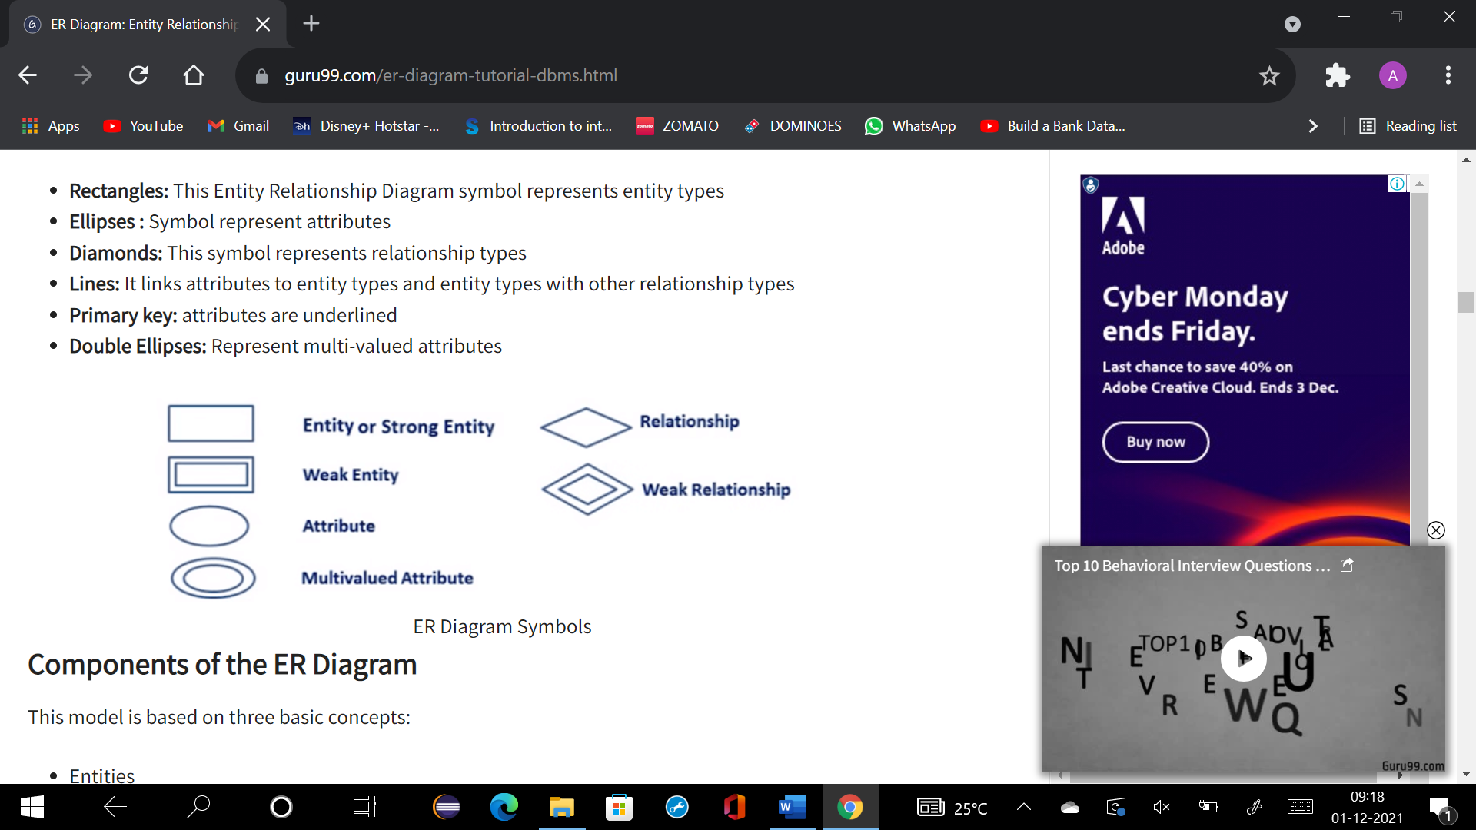
Symbols

Slide 7
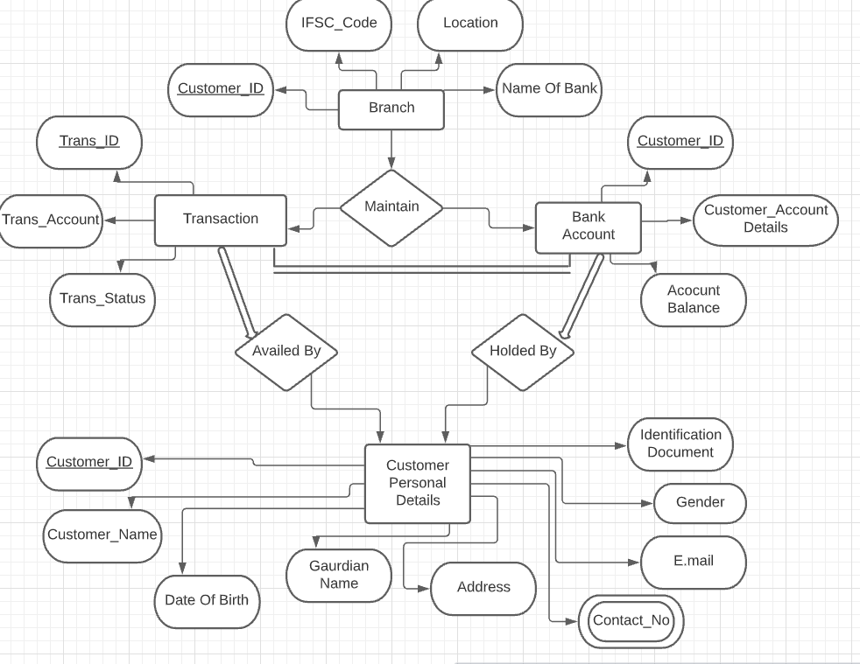
ER Model

Slide 8
Logical Models
Entities
Branch Entity-Branch ID contains attributes…Customer _ID, Name of Bank, Location, IFSC _Code. Customer _ID is the primary key.
Bank Account Entity-Bank account contains all the personal info of the customer for example- Customer _ID, Customer _Account Details, Account Balance.
Transaction Entity-Transaction entity contains all the transfer info of the customer. It contains attributes like Transaction _ID, Transaction _Account, Trans _Status. Trans _ ID is the primary key in the table.
Customer Entity-It contains attributes like Customer _ID, Customer _Name, Date of birth, Guardian Name, Address, Contact _No, E-mail, Gender, Identification Document and many more.

Slide 9
Branch maintains bank account: 1: N
One Branch can have many Accounts but one Account can not
belong to many Branches, so the relationship between Branch
and Account is one to many relationships.
Branch maintains all the transactions: 1 : N
One Branch can have many transactions but transactions can
not belong to many Branches, so the relationship between
Branch and Loan is one to many relationship.
Bank Account held by Customers: M : N
One Customer can have more than one Bank Account and
also Bank One Account can be held by one or more
Customers, so the relationship between Account and
Customers is many to many relationships.

Slide 10
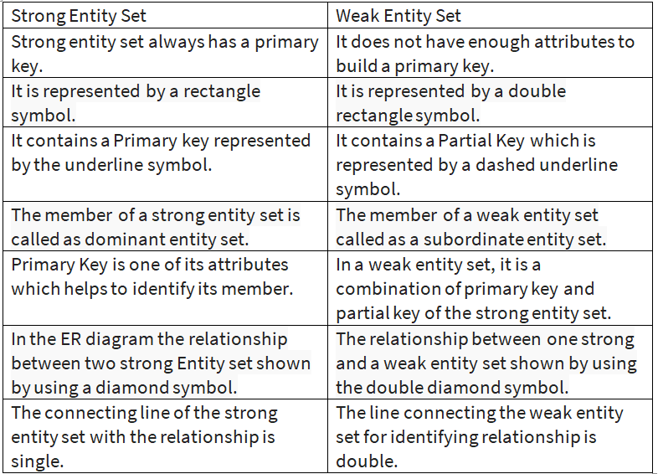
Difference Between Weak and Strong Entities

Slide 11
Constraints
Constraints are the rules that we can apply on the type of data in a table. That is, we can specify the limit on the type of data that can be stored in a particular column in a table using constraints.
PRIMARY KEY: A primary key is a field which can uniquely identify each row in a table. And this constraint is used to specify a field in a table as primary key.
FOREIGN KEY: A Foreign key is a field which can uniquely identify each row in a another table. And this constraint is used to specify a field as Foreign key.
NOT NULL: This constraint tells that we cannot store a null value in a column. That is, if a column is specified as NOT NULL then we will not be able to store null in this particular column any more.
UNIQUE: This constraint when specified with a column, tells that all the values in the column must be unique. That is, the values in any row of a column must not be repeated.
And many more…….

Slide 12
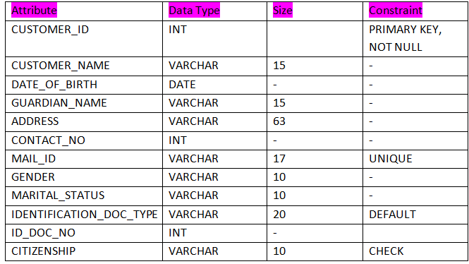
Physical Schema(customer_personal_info)
create table customer_personal_info
(
CUSTOMER_ID INT,
CUSTOMER_NAME VARCHAR(15),
DATE_OF_BIRTH DATE,
GUARDIAN_NAME VARCHAR (15),
Address VARCHAR(63),
CONTACT_NO INT,
MAIL_ID VARCHAR(17),
GENDER VARCHAR(10),
MARITAL_STATUS VARCHAR(10),
IDENTIFICATION_DOC_TYPE VARCHAR(20),
ID_DOC_NO INT,
CITIZENSHIP VARCHAR(10)
);

Slide 13
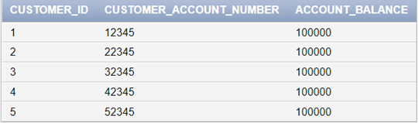

Physical Schema (account_details)
CREATE TABLE account_details(
Customer_id INT PRIMARY KEY,s
customer_account_number INT NOT NULL,
account_balance INT);

Slide 14
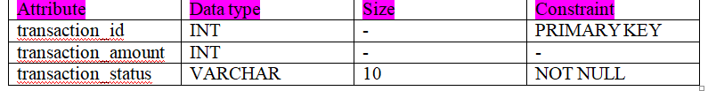
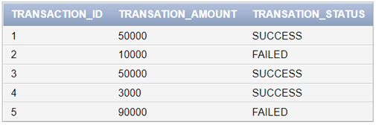
Physical Schema (transaction_details)
create table transaction_details(
transaction_id INT PRIMARY KEY,
transation_amount INT,
transation_status VARCHAR(10) NOT NULL
);

Slide 15
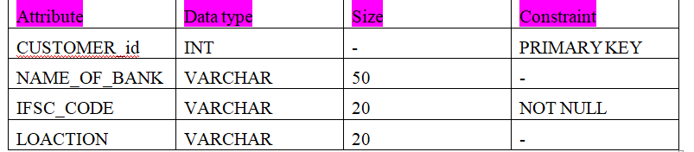
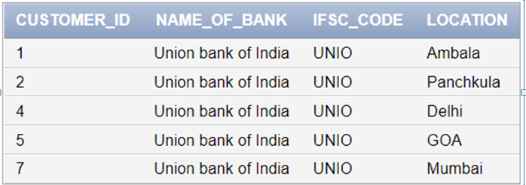
Physical Schema (branch_details)
create table branch_details(
CUSTOMER_id INT PRIMARY KEY,
NAME_OF_BANK VARCHAR(50),
IFSC_CODE VARCHAR(20) NOT NULL,
LOCATION VARCHAR(20)
);

Slide 16
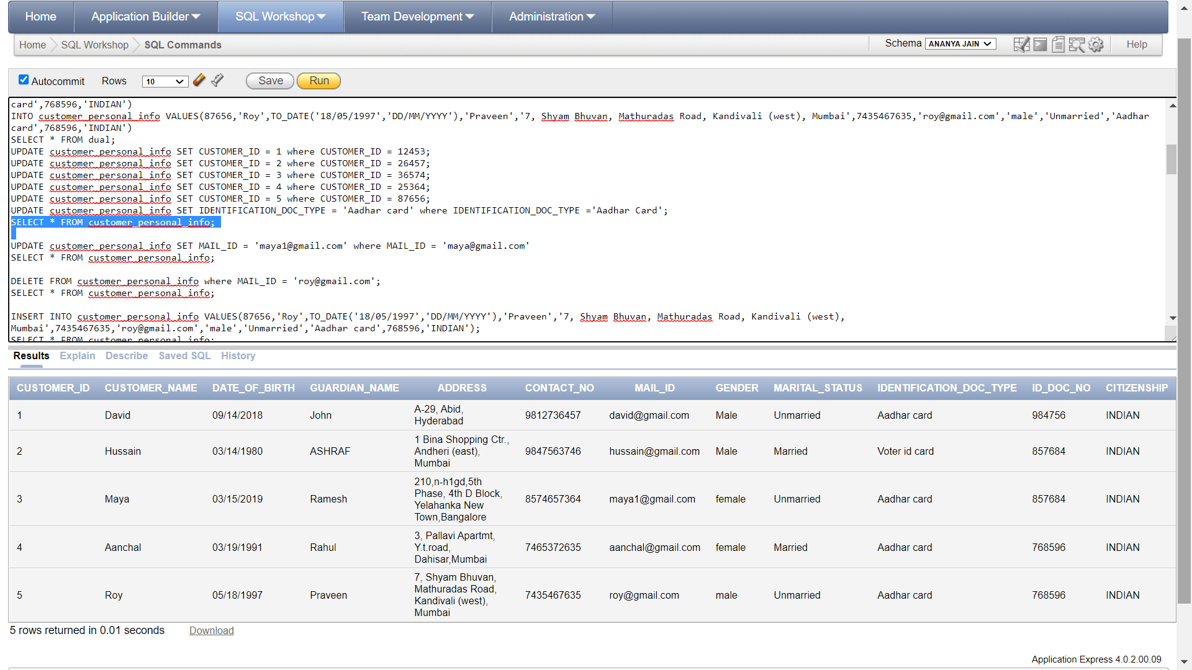
Queries
ALTER TABLE customer_personal_info ADD PRIMARY KEY(CUSTOMER_ID);
ALTER TABLE customer_personal_info MODIFY CUSTOMER_ID NOT NULL;
ALTER TABLE customer_personal_info ADD UNIQUE (MAIL_ID);
ALTER TABLE customer_personal_info MODIFY IDENTIFICATION_DOC_TYPE DEFAULT ‘Aadhar card’;
ALTER TABLE customer_personal_info ADD CONSTRAINT CITIZENSHIP CHECK (CITIZENSHIP =’INDIAN’);

Slide 17
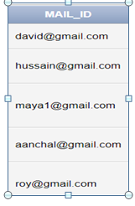
Update Command
UPDATE customer_personal_info SET MAIL_ID = ‘maya1@gmail.com’ where MAIL_ID = ‘maya@gmail.com’
Reference Table

Slide 18
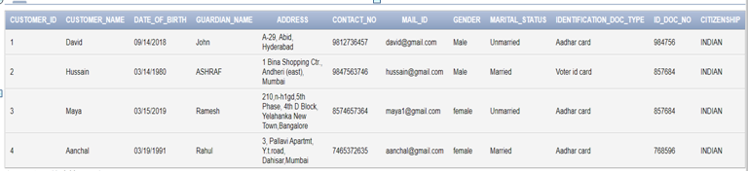
Delete Command
DELETE FROM customer_personal_info where MAIL_ID = ‘roy@gmail.com’;
Reference Table

Slide 19
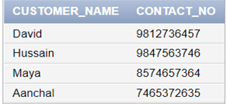

SELECT CUSTOMER_NAME , CONTACT_NO from customer_personal_info;
SELECT DATE_OF_BIRTH AS “DOB” FROM customer_personal_info;
Reference Table

Slide 20
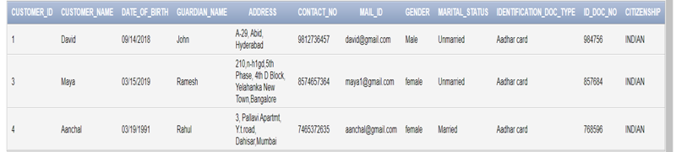

Group By
SELECT * FROM customer_personal_info WHERE IDENTIFICATION_DOC_TYPE = ‘Aadhar card’;
select IDENTIFICATION_DOC_TYPE ,COUNT(CUSTOMER_ID) from customer_personal_info group by IDENTIFICATION_DOC_TYPE;

Slide 21
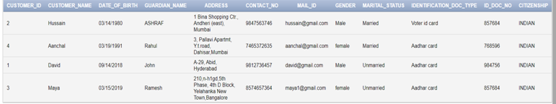
Order By
select * from customer_personal_info order by DATE_OF_BIRTH;

Slide 22

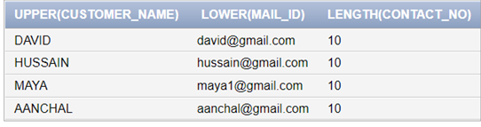
Max, Min, Upper, Lower
select
MAX(CUSTOMER_ID),MIN(CUSTOMER_ID) from customer_personal_info;
select
UPPER(CUSTOMER_NAME),Lower(MAIL_ID),LENGTH(CONTACT_NO) from customer_personal_info;

Slide 23
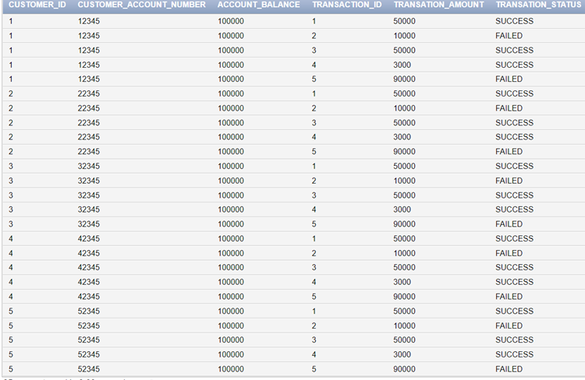
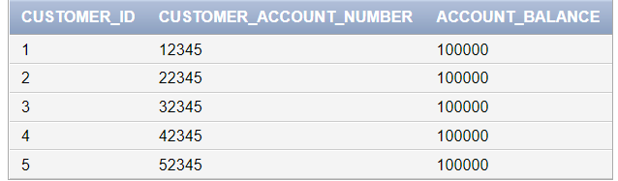
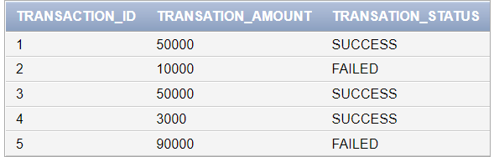
Cross Join
select * from account_details cross join transaction_details;
account_details
transaction_details

Slide 24
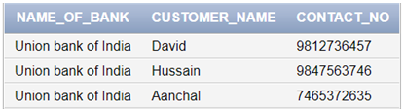
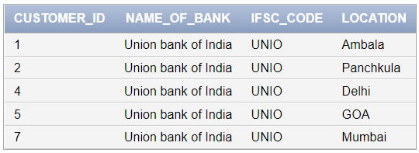
Inner Join
SELECT branch_details.NAME_OF_BANK, customer_personal_info.CUSTOMER_NAME
customer_personal_info.CONTACT_NO
FROM customer_personal_info
INNER JOIN branch_details ON
customer_personal_info.CUSTOMER_ID = branch_details.CUSTOMER_id;
branch_details
Customer_personal_info

Slide 25
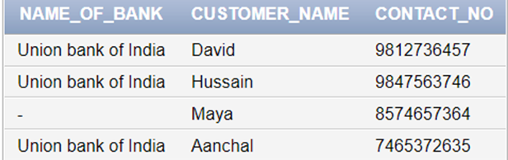
Left Join
SELECT branch_details.NAME_OF_BANK, customer_personal_info.CUSTOMER_NAME
customer_personal_info.CONTACT_NO
FROM customer_personal_info
LEFT JOIN branch_details
ON customer_personal_info.CUSTOMER_ID = branch_details.CUSTOMER_id;
branch_details
Customer_personal_info

Slide 26
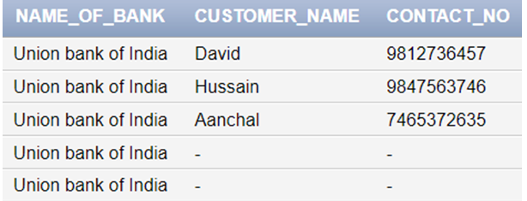
Right Join
SELECT branch_details.NAME_OF_BANK, customer_personal_info.CUSTOMER_NAME
customer_personal_info.CONTACT_NO
FROM customer_personal_info
RIGHT JOIN branch_details
ON customer_personal_info.CUSTOMER_ID = branch_details.CUSTOMER_id;
branch_details
Customer_personal_info

Slide 27
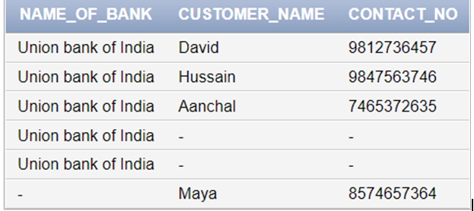
Full Join
SELECT branch_details.NAME_OF_BANK,
customer_personal_info.CUSTOMER_NAME
customer_personal_info.CONTACT_NO
FROM customer_personal_info
FULL JOIN branch_details
ON customer_personal_info.CUSTOMER_ID = branch_details.CUSTOMER_id;
branch_details
Customer_personal_info

Slide 28
Conclusion and Future Work
Bank management system is a virtualization of transactions in banking system. The banking system are used manual working but when we used online banking system it is totally virtualization process which avoid manual process and converts it in automatic process. If user can make a transaction in bank management system it is available in any were also user can link Aadhar with account. Bank management system is saving the time with accuracy than bank manual system.

Slide 29
Bibliography
Code quotient
W3schools
Wikipedia
Geeks for geeks
Database system concepts by Abraham Silberschatz, Henry F. Korth, S. Sudarshan

Slide 30
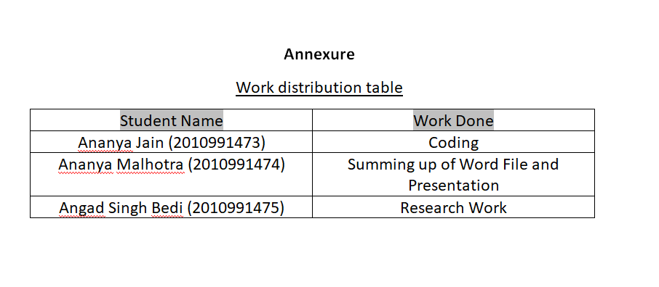

Slide 31
Thank You

